Slide 2



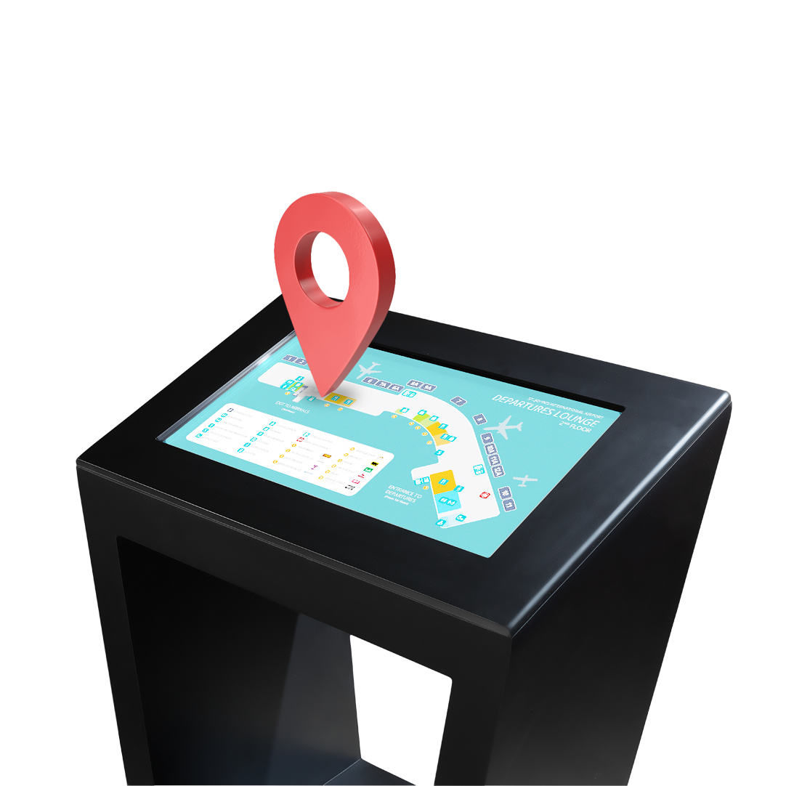
”The hospitals’ reborn with Moborn”

Slide 3

Booking a doctor appointment is always a tedious task
I couldn’t find the doctor’s room , it made me late for my appointement
I had a cast put on yesterday, I struggled to go home with it
The healthcare structure has some quality, accessibility and organisational issues

Slide 4
And here we goo

Slide 5

What is Hygie ?
Hygie is an innovative solution, A web application embedded in Techmology’s Moborne touch terminal . Used mainly in public large hospitals to assist patients through their journey.

Slide 6
How can hygie fix people’s issues ?
Orientation
Reservation
Transportation
Hygie gives directions to reach any hospital departement desired
Hygie offers rides for patients after their consultation
Hygie allows the user to reserve an appointment via the Moborn

Slide 7
What determines our application’s quality ?
01
02
03
04
05
Access
Utlization
Open to the public
Pratical and effective
Efficiency
Sustainability
Learning
Less effort whilst booking an appointement
Long term investement that occasionnaly needs maintenance
Data collector used in data analysis and machine learning

Slide 8
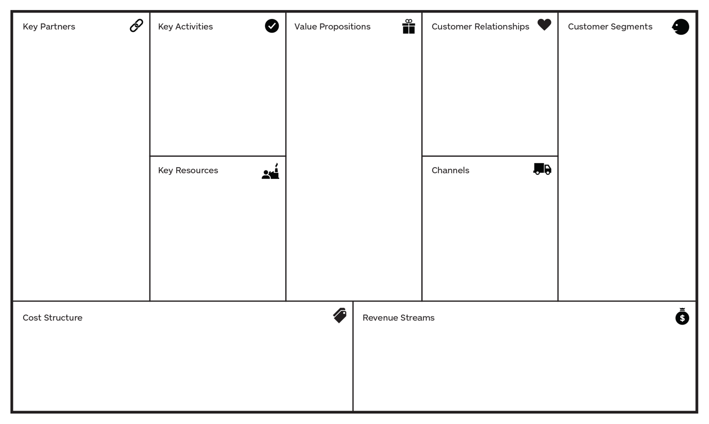
Business model Caneva
-Appointment
reservation
-Orientation
-Transport
-List of nightshift
Pharmacies
-Covid service
-Reduce the load on
The reception level
-showing the shortest
way in general and
the adequate one for
disabled people.
-Assuring the
disponiblity of rides for
patients who want to
-Reducing the search
time in case of an
urgent
need of medication
-Appointment for
covid testing and
vaccinating 1st and
2nd dose
-Adults in general
And kids too
-Public/private hospitals
-Pharmacies
-Companies of passenger cars with drivers (Yassir…)
-Self service
-Moborn machine
-Vehicles
-Partnerships
-Repair worker
-Mails
-Phone numbers
-The hosting of the web application
-Software implementation and machine cost
-Maintenance cost
-Companies of passenger cars with drivers
-Pharmacies that pay to get localized in the Moborn
- Public/private hospitals and doctors

Slide 9
Thank you for your attention
Do you have any questions?
contact@Hygie.club
Hygie.club

